Slide 1
MANUFACTURING
Shift Planning Optimizer Agent
Subfunction
Maturity
Dynamically adjusts shift schedules to reduce downtime and improve staffing.
Hi-Tech, Industrial
Homerun
Supervisors manually create shift plans using HR, ERP, and production data, often resulting in staffing mismatches from absences, demand shifts, or equipment issues
Current Workflow Challenges
Manual aggregation of rosters, skills, and absentee data doesn’t scale with fluctuating demand and availability
Lack of real-time data on absenteeism and machine readiness causes delays
Overstaffing or understaffing impacts labor costs and output
Reactive shift adjustments are slow and prone to errors
Key Features
Business Impact
From
Ingests labor rosters, skills matrix, absentee data, and shift rules from HR and ERP systems
Shift Coverage Rate → Better alignment of labor supply with demand improves production continuity
Labor Utilization → Optimized shift plans ensure resources are effectively deployed
Aligns staffing levels with production demand and machine availability from MES
Overtime Hours → More accurate forecasting reduces the need for costly overtime
Recommends optimal shift schedules and flags under- or over-staffing risks
Auto-forecast staffing needs, identify gaps, and generate optimal shift plans aligned to labor availability, skills and machine readiness, plus proactive understaff/overstaff alerts
Work Delays → Optimized shift plans reduce unplanned delays
To
Delivers updated shift plans and alerts to supervisors via email
AI Agent drives real-time intent identification, intelligent routing, and hyper-personalized recommendations
Key User(s)
Shift Planner
Production Supervisor
Operations Manager

Slide 2
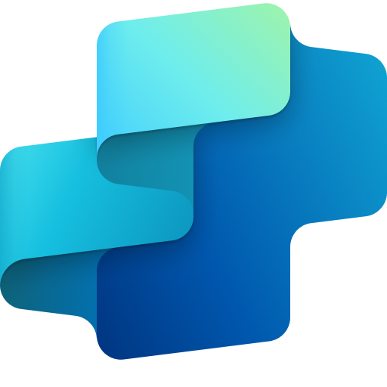
Manufacturing
Shift planning optimizer agent
Available with:
Copilot Studio
Scenario level:
Extend
Import labor & shift data
Match labor with demand
Generate optimized shift plan
Aggregates workforce availability, skill sets, absentee data, and shift policies from HR and ERP systems.
Cross-references current staffing levels with real-time production load and equipment readiness.
Applies optimization logic to suggest ideal skill matched staffing and flag areas of excess or insufficient coverage.
Leverages data like labor availability, machine readiness, and workforce constraints to automatically generate and adjust shift schedules—ensuring optimal staffing, minimizing downtime, and improving overall operational efficiency.
KPIs impacted
Value benefit
AI Agent
Connection to HR system (e.g., Workday) for labor availability and absenteeism
Connection to ERP (e.g., Dynamics 365) for shift rules and skills mapping
Connection to Workflow Automation Platforms (e.g. Power Automate) to trigger updates from leave requests or HR workflow changes
AI Agent
Connection to MES (e.g., Dynamics 365 Supply Chain) for machine availability and production load
Connection to ERP (e.g., Dynamics 365) for retrieving current work orders and equipment assignments
Connection to Data Analytical Tools (e.g. Microsoft Fabric) for advanced labor-to-demand matching logic
AI Agent
Connection to workflow automation services (e.g, Power Automate) for logic-based optimization and rule enforcement
Connection to Analyzing Tools (e.g. Excel) for maintaining configurable planning templates and constraints
Benefit: Aggregates workforce availability, skill sets, absentee data to ensure visibility into staffing capacity and compliance constraints.
Benefit: Matches labor with demand to minimize downtime by aligning labor with equipment and workload.
Benefit: Generates accurate and optimized shift plans incorporating skills, etc.
Optimizes Labor Utilization
Increases Shift Coverage Rate
Send shift plan updates
Reduces Overtime Hours
Communicates optimized shift plans and real-time alerts to relevant supervisors.
Reduces Unplanned Delays
Cost Savings
AI Agent
Connection to Communication Tools (e.g. Outlook) for email notifications
Connection to communication platform (e.g., Teams) for alerts and collaboration on shift changes
Employee Experience
Benefit: Sends shift plan updates to improve visibility and response time to scheduling changes.

Slide 3
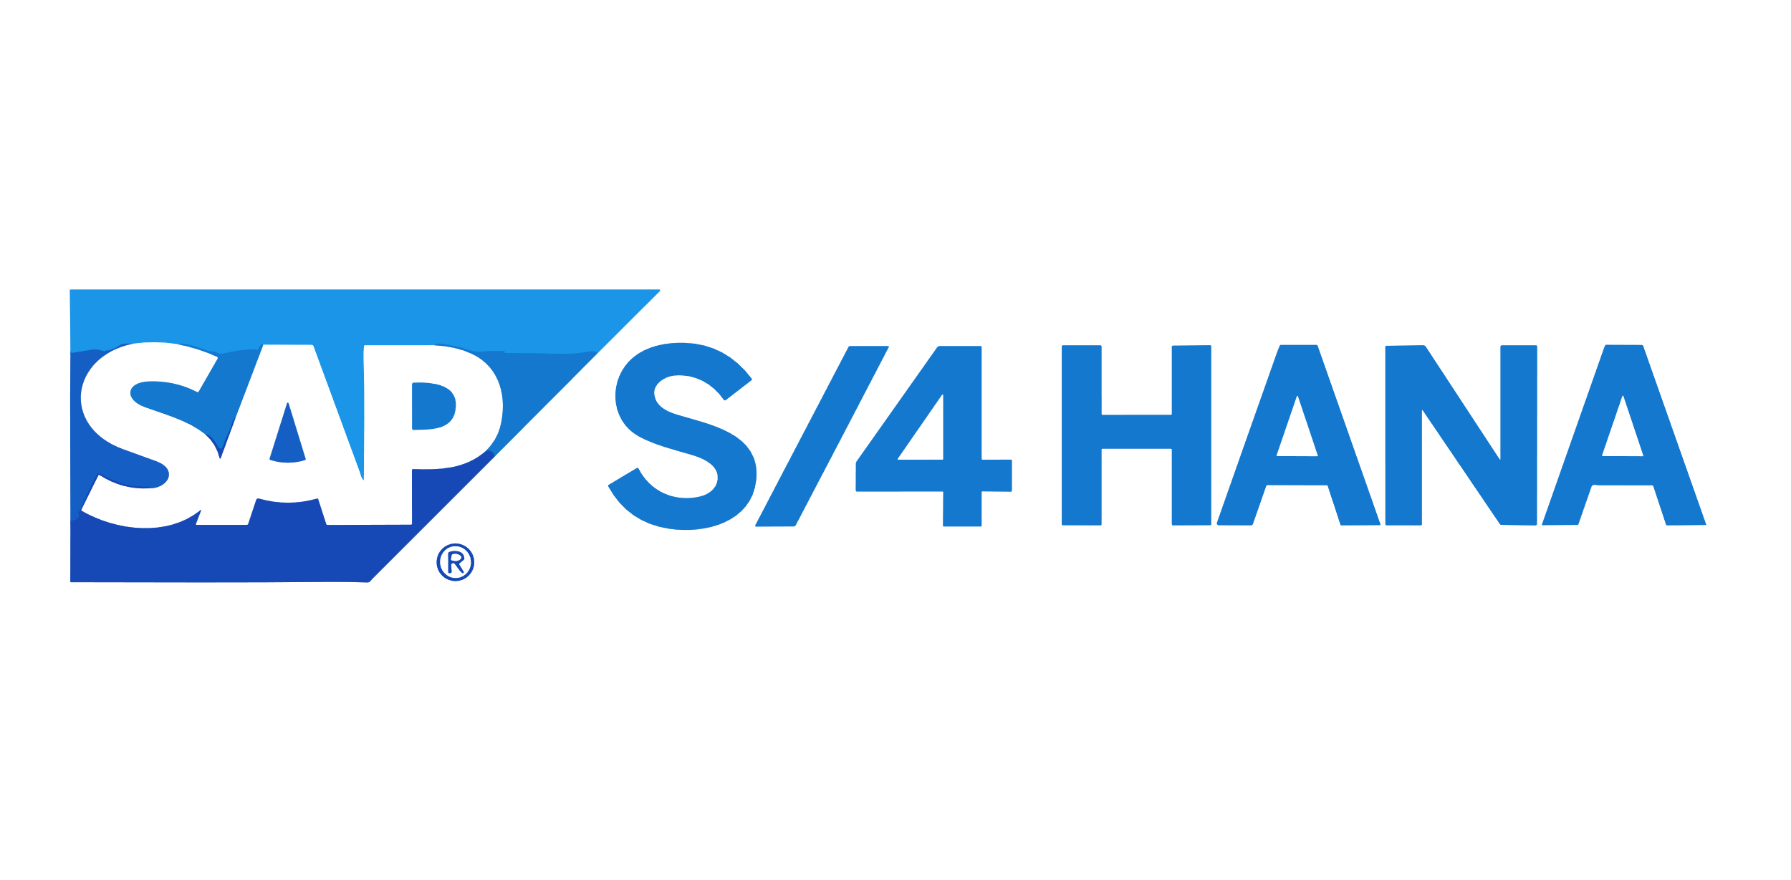
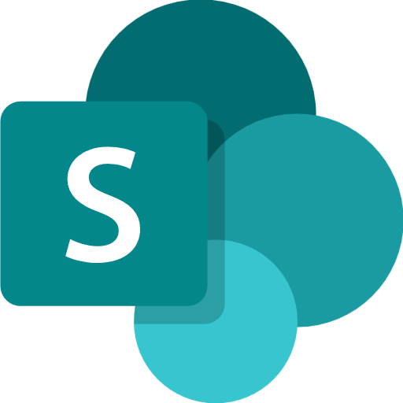
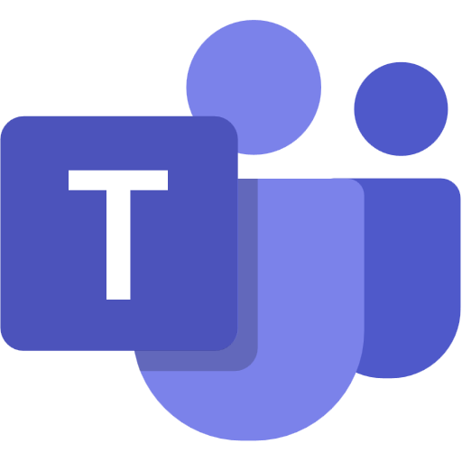
MANUFACTURING INDUSTRY
Shift Planning Optimizer Agent
Dynamically adjusts shift schedules to reduce downtime and improve staffing.
Key Considerations to Address
Fetches labor availability, historical staffing and shift policies from HR and ERP systems (e.g., Workday, Dynamics 365) to maintain up-to-date workforce data
References machine status from MES (e.g., Dynamics 365) and work orders to align staffing with operational demand, generating staffing reports.
Runs shift optimization with skill matching and predefined business rules, to provide optimized schedules
Sends shift plan updates via collaboration platforms (e.g., Outlook, Teams), to supervisors based on severity, staffing gaps, or production impact.
PII includes employee names, roles, shifts and absences.
Base Pre-trained OpenAI Models / custom Open AI models (preview)
Orchestrator
Low Risk
schedule_confidence
High Risk
9c. Updates the instructions and prompts and set the confidence threshold
Licensed Users
0
1
4a. Invokes action
1a. Periodically syncs inventory details
3b. Forwards the query
ERP System
1b. Periodically syncs workforce details
Tools
Knowledge Base
3a. Asks to prepare shift for a certain production plan
Shift Planner
2. Inventory and Shifts are pushed
Channels
HR System
Rest API
Structured Records
8. Shifts are published post review
5b. Generates a brief rationale for shift requirements and lists key properties.
Prompts
Connector
Shifts
LEGEND
5a. Pulls skills, estimated effort, workforce availability based on the production plan
Structured Records
Unstructured Documents (versioned)
Production Supervisor
D365 Customer Portal
6. Generates smart scheduling plan
7a. Confidence >= 0.8, auto publish
7b. Confidence <0.8, manual review
Dataverse
Operations Manager
SharePoint
9a. Agent logs are displayed
Copilot Studio Agent
Conversation Transcript
Agent Ops (logging, audit, observability)
Agent-to-Agent
Workflow
Production Schedule Optimizer Agent
Maintenance Prediction Agent
App Insights
9b. Logged entries are reviewed
Reference Architecture Assumptions
Agent will be hosted on Teams channel with Microsoft authentication
Planner, Supervisor, Manager will have M365 license to access the agent,
ERP and HR systems would expose APIs or have connectors to fetch stocks, employee schedules and skills.
PDF, PPTX and DOCX are the supported knowledge in SharePoint. Dataverse knowledge can be max two with max 15 tables each.
Other dependent agents should be ready and discoverable to be associated with this agent
Copilot Studio Kit - Extend
Flow / Connector
MS Teams

